Slide 1
Microwave Components

Slide 2
Microwave Components
Microwave systems consists of many Microwave components, mainly with source at one end and load at the other, which are all connected with waveguides or coaxial cable or transmission line systems.
The properties of waveguides are high SNR, lower attenuation and lower insertion loss.
Consider a waveguide having 4 ports. If the power is applied to one port, it goes through all the 3 ports in some proportions where some of it might reflect back to the same port.

Slide 3
Scattering Parameter
For a two-port network, if the power is applied at one port, most of the power escapes from the other port, while some of it reflects back to the same port. For a two-port network, 2 × 2 = 4 combinations are likely to occur.
The travelling waves with associated powers when scatter out through the ports, the Microwave junction can be defined by S-Parameters or Scattering Parameters, which are represented in a matrix form, called as "Scattering Matrix".

Slide 4
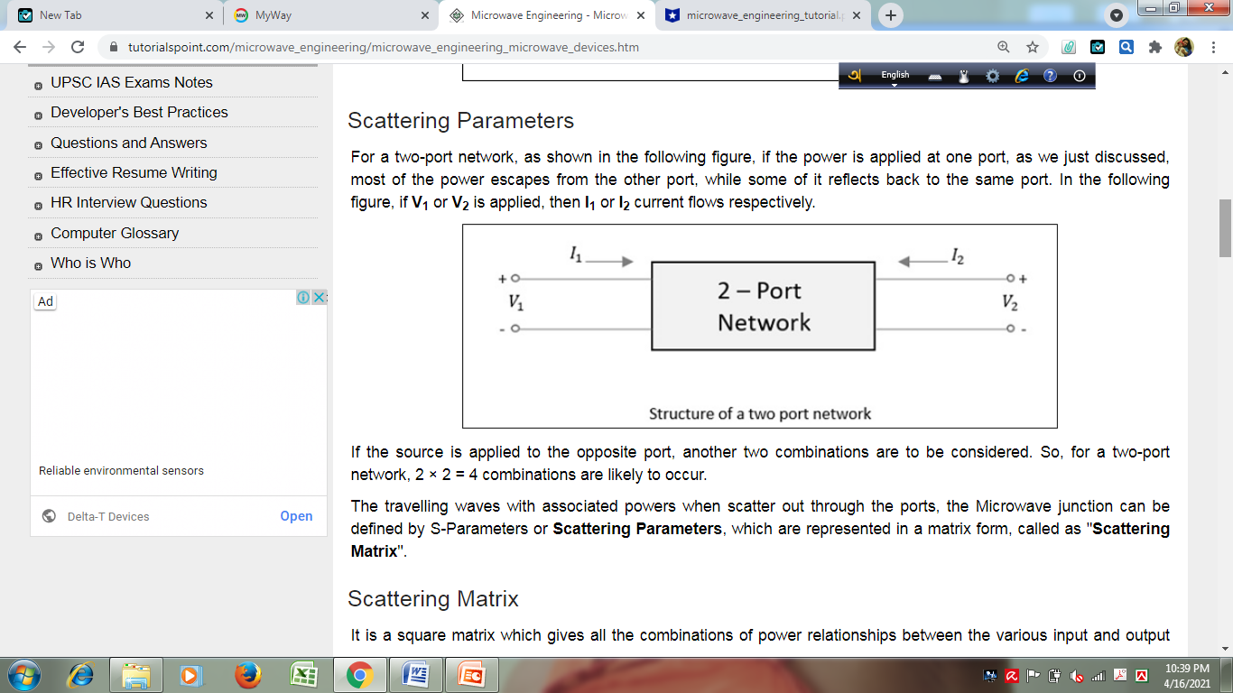

Slide 5
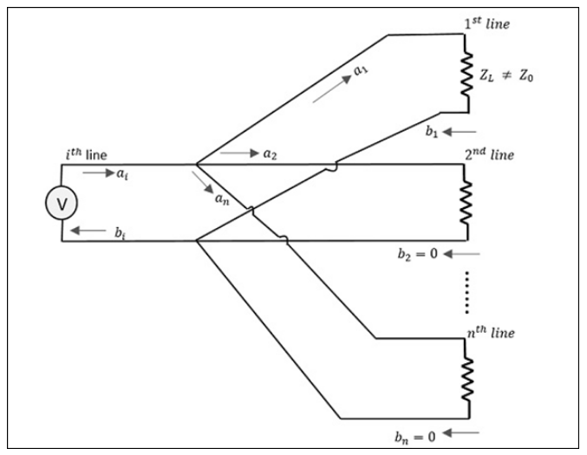
Scattering Matrix

Slide 6
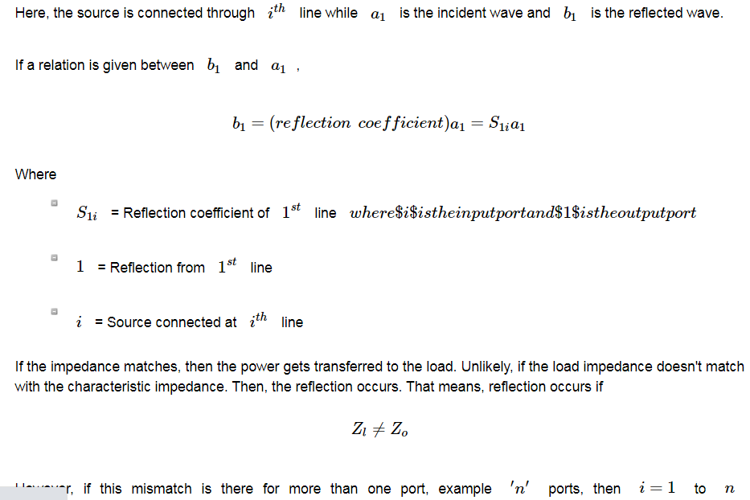

Slide 7
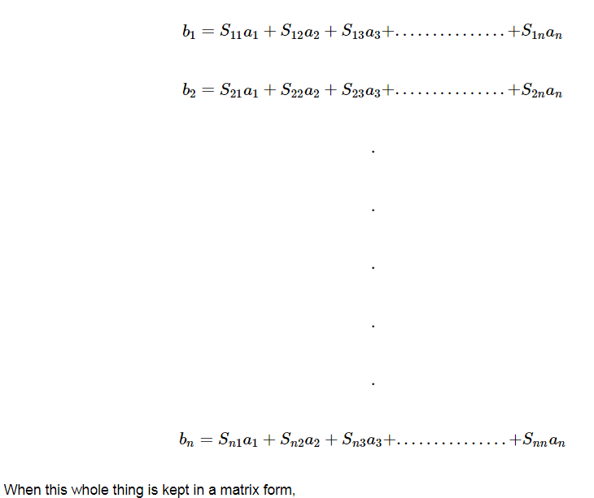

Slide 8
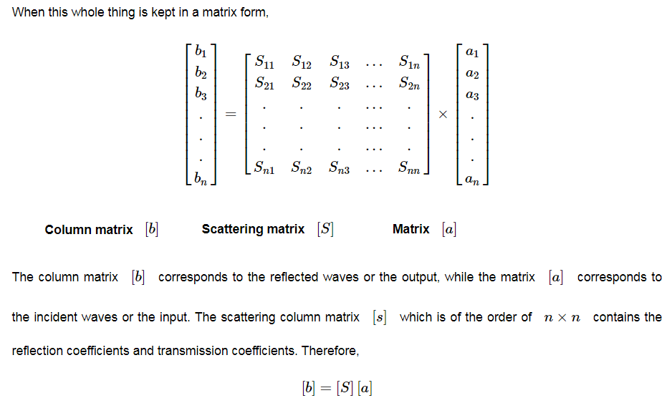

Slide 9
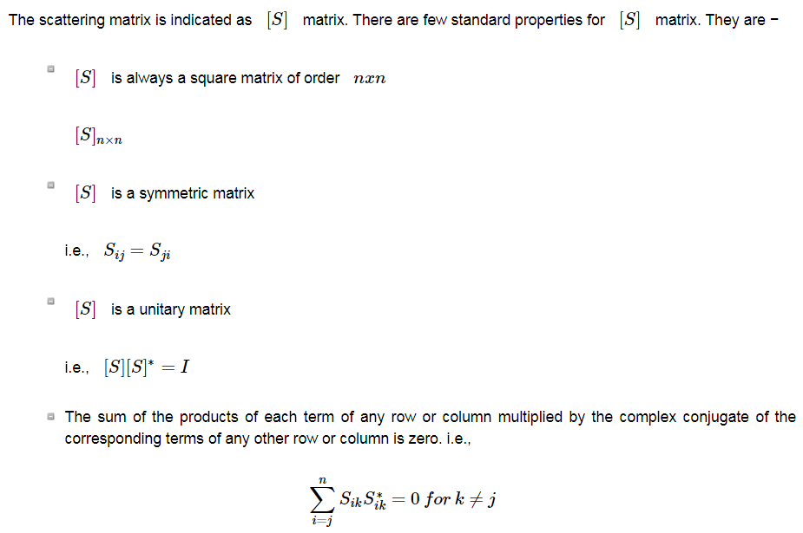

Slide 10
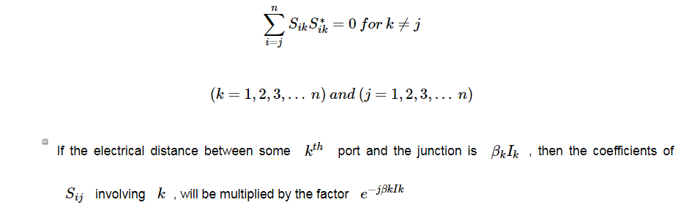

Slide 11
Waveguide Tees

Slide 12
H-Plane Tee

Slide 13
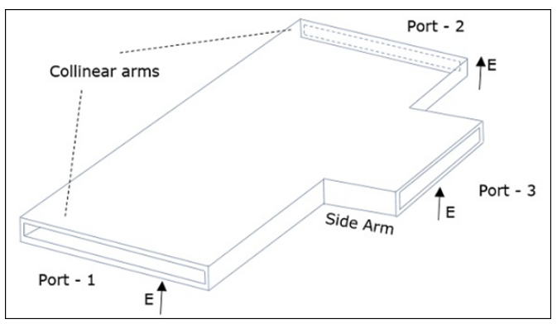
The connection made by the sidearm to the bi-directional waveguide to form the serial port.

Slide 14
H-Plane Tee
An H-Plane Tee junction is formed by attaching a simple waveguide to a rectangular waveguide which already has two ports. The arms of rectangular waveguides make two ports called collinear ports i.e., Port1 and Port2, while the new one, Port3 is called as Side arm or H-arm. This H-plane Tee is also called as Shunt Tee.
As the axis of the side arm is parallel to the magnetic field, this junction is called H-Plane Tee junction. This is also called as Current junction, as the magnetic field divides itself into arms.

Slide 15
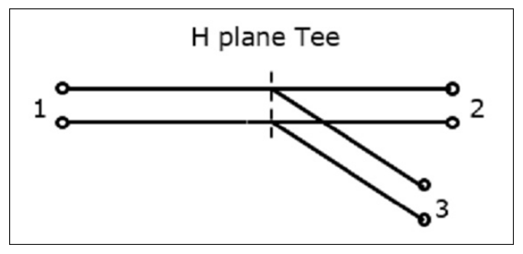

Slide 16
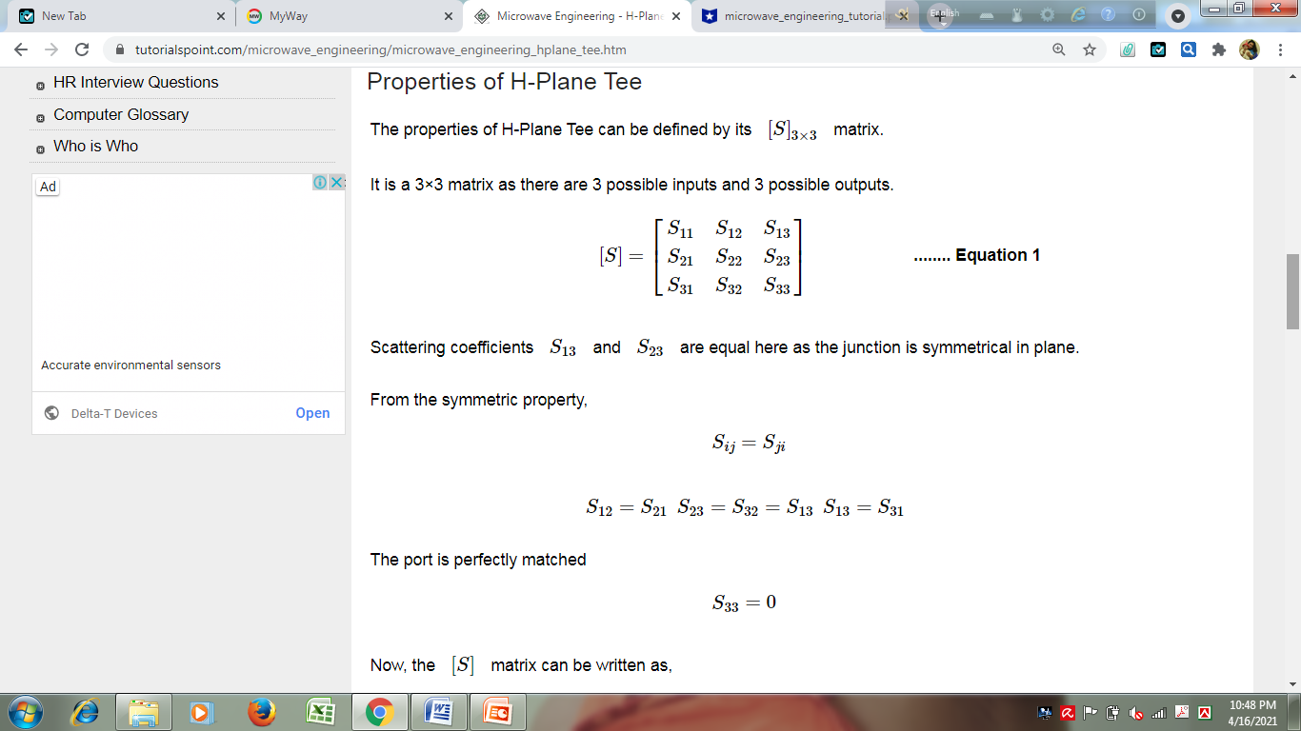
Properties of H Plane Tee

Slide 17
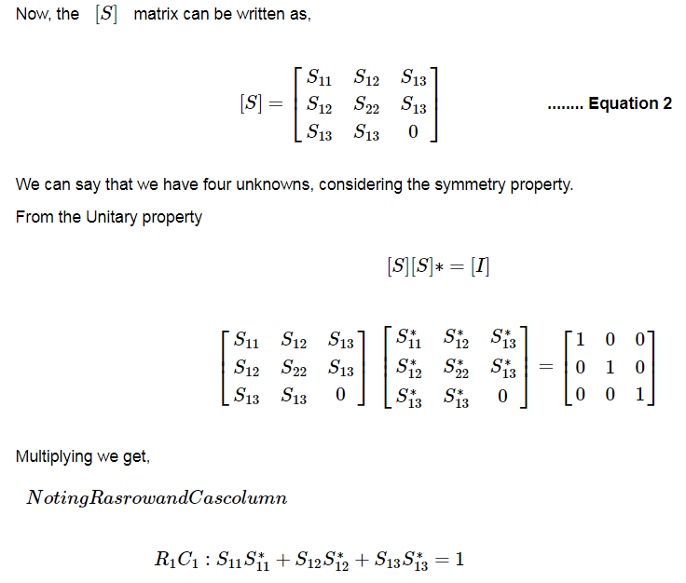

Slide 18
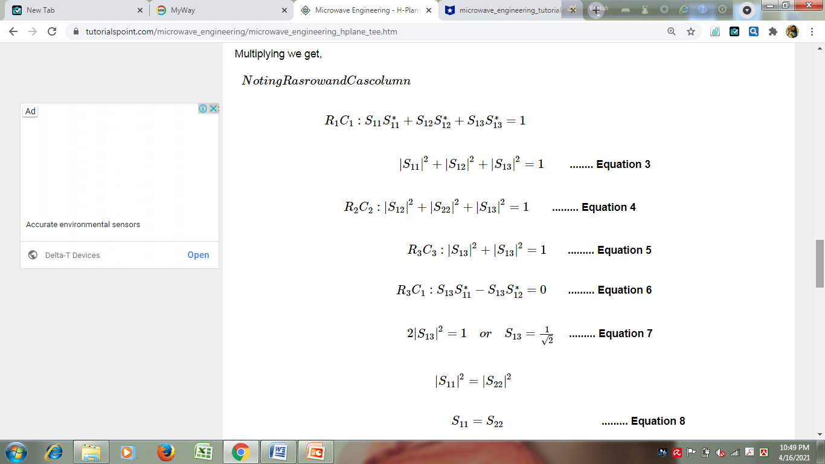

Slide 19
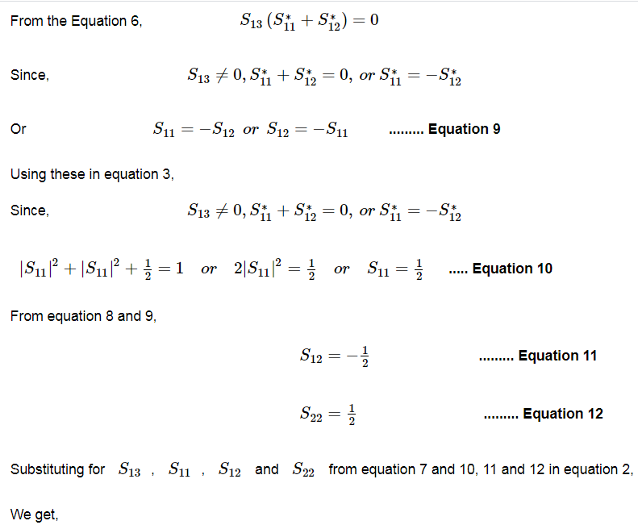

Slide 20
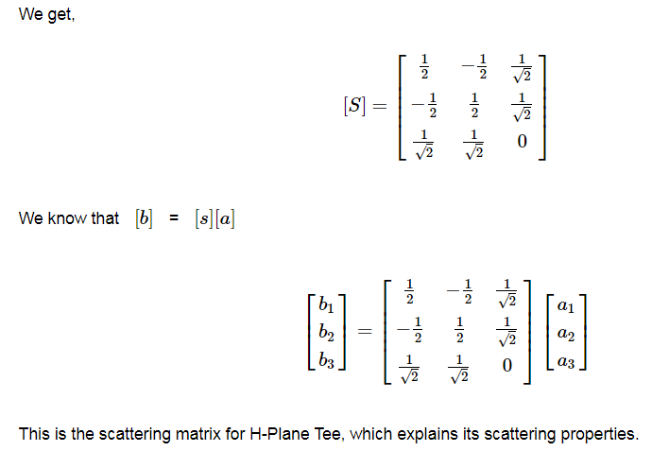

Slide 21
Home Work

Slide 22
E-Plane Tee

Slide 23
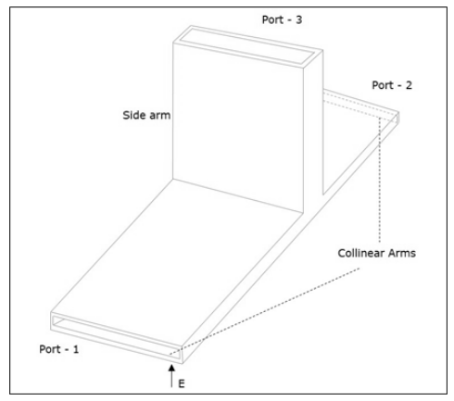
The connection made by the sidearm to the bi-directional
waveguide to form the parallel port.

Slide 24
E-Plane Tee
An E-Plane Tee junction is formed by attaching a simple waveguide to the broader dimension of a rectangular waveguide, which already has two ports. The arms of rectangular waveguides make two ports called collinear ports i.e., Port1 and Port2, while the new one, Port3 is called as Side arm or E-arm. This E-plane Tee is also called as Series Tee.
As the axis of the side arm is parallel to the electric field, this junction is called E-Plane Tee junction. This is also called as Voltage or Series junction. The ports 1 and 2 are 180° out of phase with each other.

Slide 25
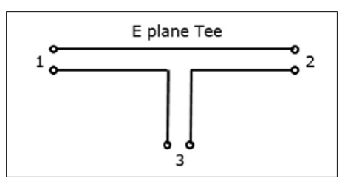

Slide 26
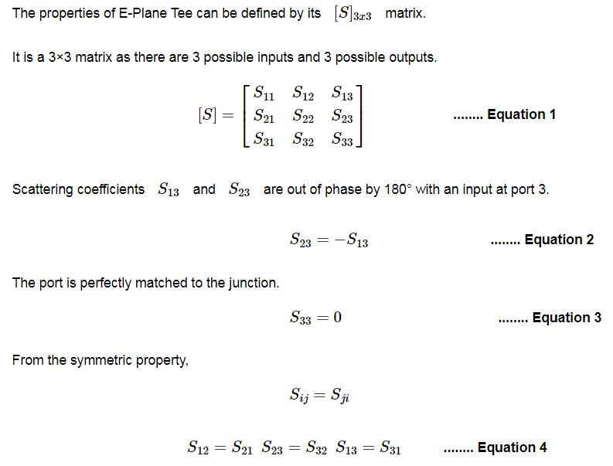
Properties of E plane Tee

Slide 27
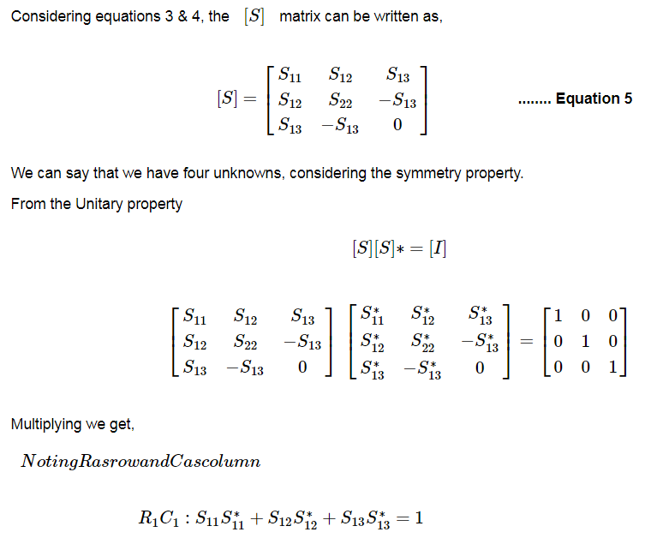

Slide 28
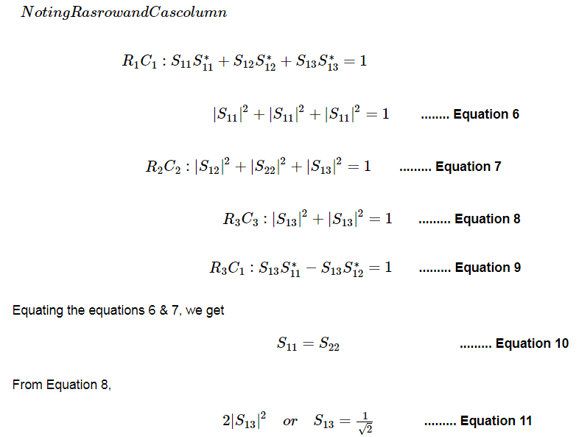

Slide 29
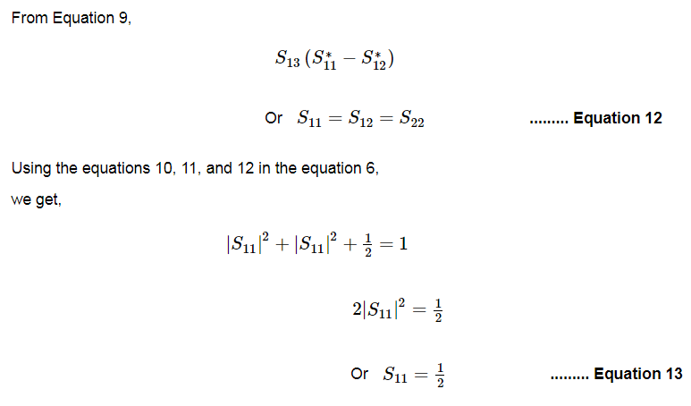

Slide 30
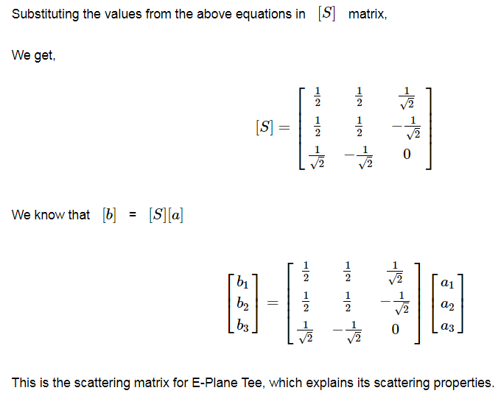
Equation 5

Slide 31
E-H Plane Tee

Slide 32
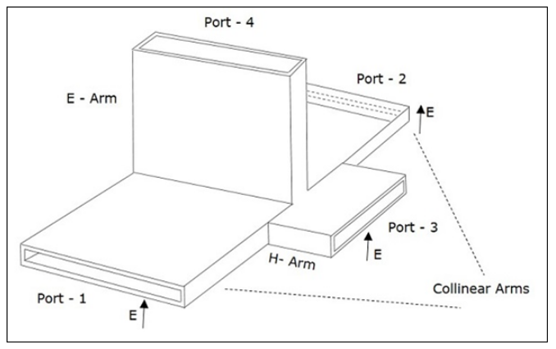
The connection made by the side arms to the bi-directional waveguide to form both parallel and serial ports

Slide 33
E-H Plane Tee
An E-H Plane Tee junction is formed by attaching two simple waveguides one parallel and the other series, to a rectangular waveguide which already has two ports. This is also called as Magic Tee, or Hybrid or 3dB coupler.
The arms of rectangular waveguides make two ports called collinear ports i.e., Port 1 and Port 2, while the Port 3 is called as H-Arm or Sum port or Parallel port. Port 4 is called as E-Arm or Difference port or Series port.

Slide 34
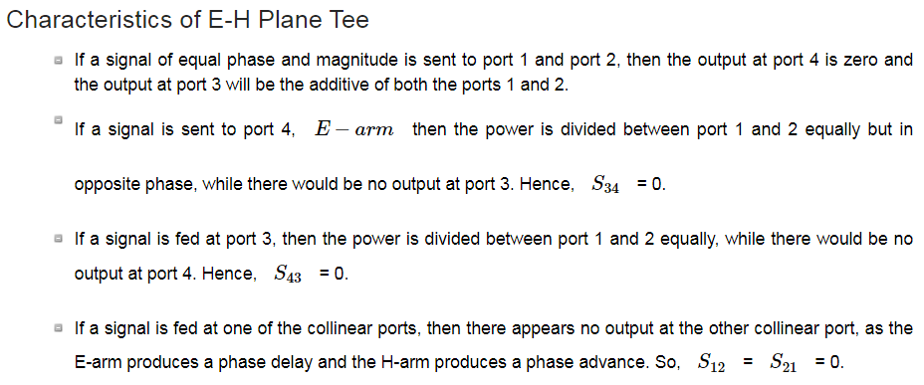

Slide 35
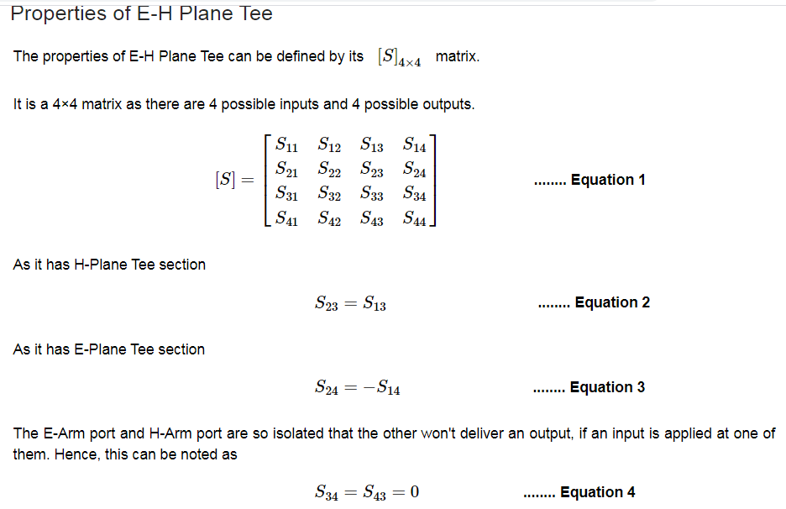

Slide 36
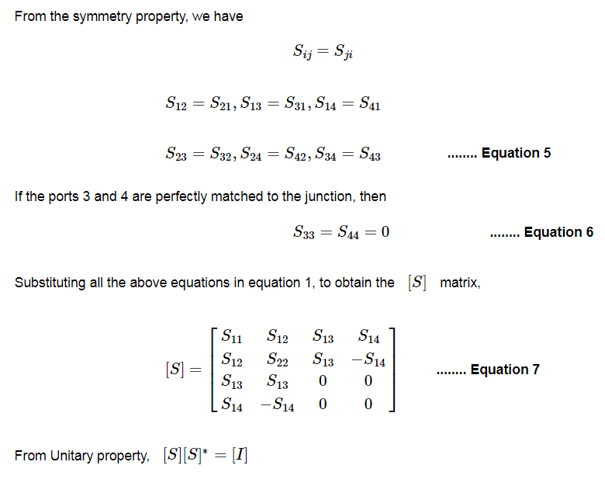

Slide 37
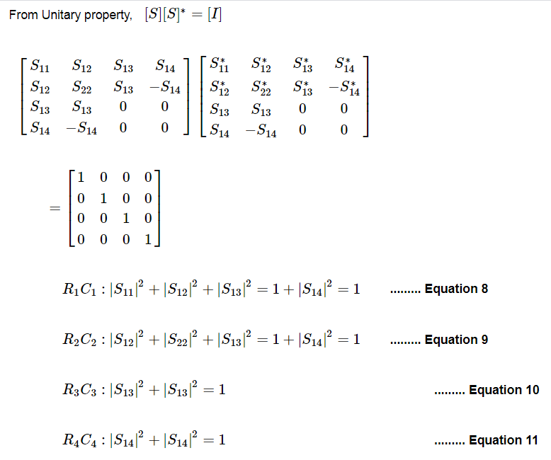

Slide 38
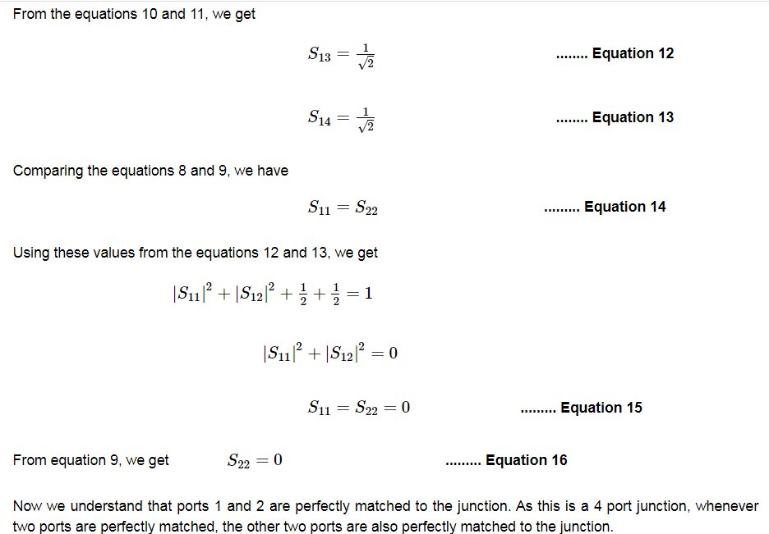

Slide 39
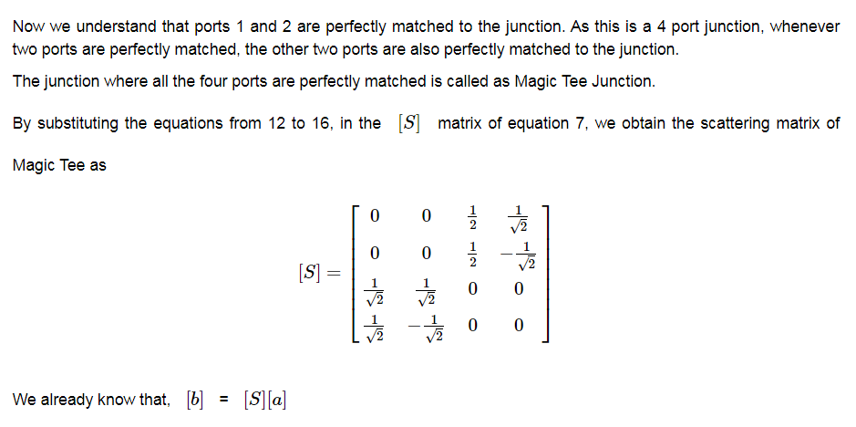

Slide 40
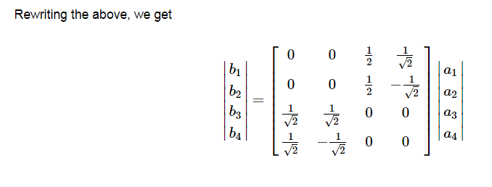

Slide 41
